Slide 1
LECTURE 5- WORDPRESS
BY ADNAN MAJEED
LECTURER

Slide 2
XAMPP SERVER & WORDPRESS
DOWNLOAD AND INSTALL XAMPP SERVER IN C DRIVE COMPUTER
DOWNLOAD WORPDRESS
COPY WORDPRESS FOLDER IN HTDOCS IN XAMPP FOLDER
CREATE DATABASE FOR WORDPRESS IN PHPMYADMIN XAMPP
CLICK ON PRIVILIGES CREATE NEW USER ACCOUNT
CREATE USERNAME AND PASSWORD FOR WORDPRESS
NOW INSTALL WORDPRESS IN COMPUTER

Slide 3


Slide 4
LOGIN TO WORDPRESS
NOW WRITE DATABASE NAME WHICH YOU CREATED IN PHPMYADMIN
WRITE USER NAME AND PASSWORD
TYPE
DATABASE HOST --> LOCALHOST
CLICK SUBMIT
RUN THE INSTALLATION

Slide 5
SITE TITLE AND USERNAME
NOW ADD SITE TITLE OF YOUR NEW WEBSITE
ADD SITE NAME AND USERNAME AND PASSWORD
WRITE WORDPRESS DASHBOARD USERNAME AND PASSWORD
SUCH AS ADMIN AND ADMIN
AFTER INSTALLATION OF WORDPRESS CLICK LOGIN
NOW LOGIN TO YOUR WORDPRESS WHICH YOU CREATED ON WORDPRESS INSTALLATION

Slide 6
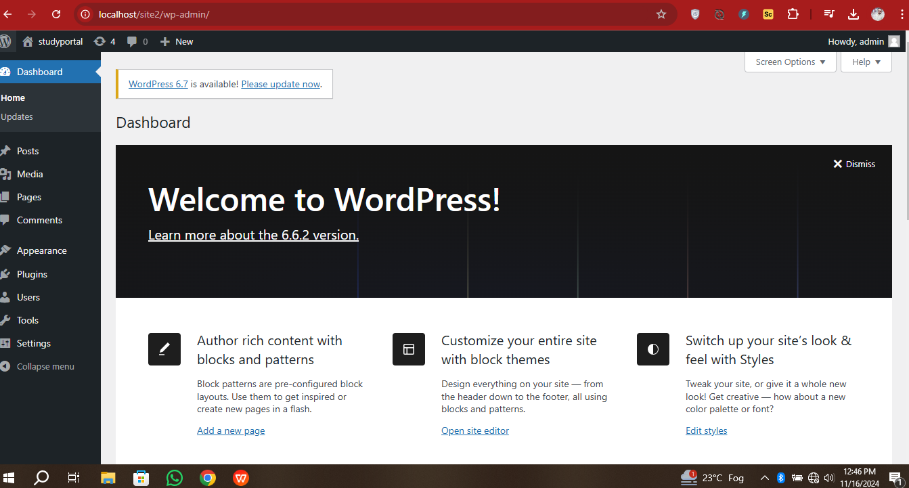
WORDPRESS DASHBOARD

Slide 7
ADD THEMES
click on add new themes
add new themes to your new website
install theme and activate themes
now add pages
now add posts to your new website

Slide 8
THANKS

